Slide 1
COMPUTER FUNDAMETALS
INTODUCTION TO COMPUTER SYSTEM

Slide 2
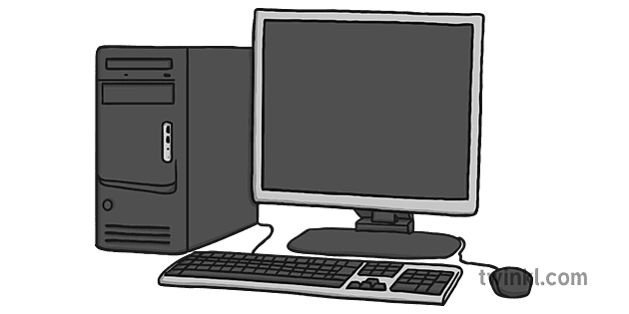
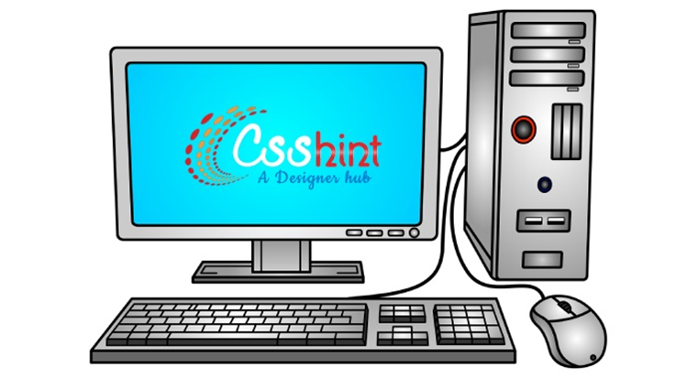
What Is Computer?
A computer is an electronic device that manipulates information, or data. It has the ability to store, retrieve, and process data. You may already know that you can use a computer to type documents, send email, play games, and browse the Web. You can also use it to edit or create spreadsheets, presentations, and even videos.

Slide 3
Characteristics of Computer
Speed- A computer works with much higher speed and accuracy compared to humans while performing mathematical calculations. Computers can process millions (1,000,000) of instructions per second. The time taken by computers for their operations is microseconds and nanoseconds.
Accuracy- Computers perform calculations with 100% accuracy. Errors may occur due to data inconsistency or inaccuracy.
Diligence-A computer can perform millions of tasks or calculations with the same consistency and accuracy. It doesn’t feel any fatigue or lack of concentration. Its memory also makes it superior to that of human beings.

Slide 4
Characteristics of Computer
Versatility- Versatility refers to the capability of a computer to perform different kinds of works with same accuracy and efficiency.
Reliability- A computer is reliable as it gives consistent result for similar set of data i.e., if we give same set of input any number of times, we will get the same result.
Automation-Computer performs all the tasks automatically i.e. it performs tasks without manual intervention.

Slide 5
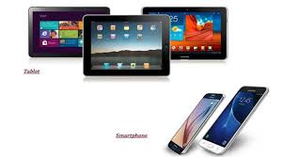
Types Of Computer
Desktop computers- Many people use desktop computers at work, home, and school. Desktop computers are designed to be placed on a desk, and they're typically made up of a few different parts, including the computer case, monitor, keyboard, and mouse.
Laptop computers- The second type of computer you may be familiar with is a laptop computer, commonly called a laptop. Laptops are battery-powered computers that are more portable than desktops, allowing you to use them almost anywhere.

Slide 6
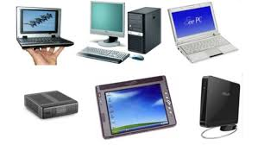
Types Of Computer
Tablet computers- Tablet computers—or tablets—are handheld computers that are even more portable than laptops. Instead of a keyboard and mouse, tablets use a touch-sensitive screen for typing and navigation. The iPad is an example of a tablet.
Servers- A server is a computer that serves up information to other computers on a network. For example, whenever you use the Internet, you're looking at something that's stored on a server. Many businesses also use local file servers to store and share files internally.

Slide 7


